Slide 1


McCoy Building Energy Dashboard Project
Link to the Website: https://turnkey-crowbar-351921.uc.r.appspot.com/

Slide 2
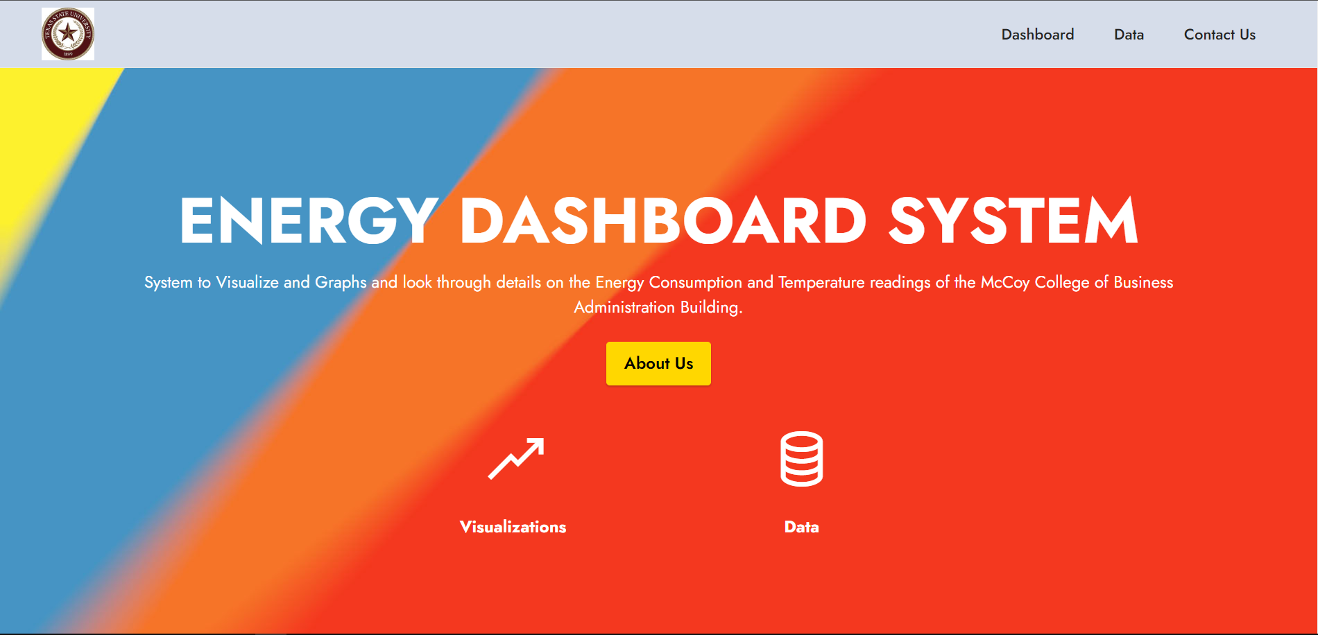
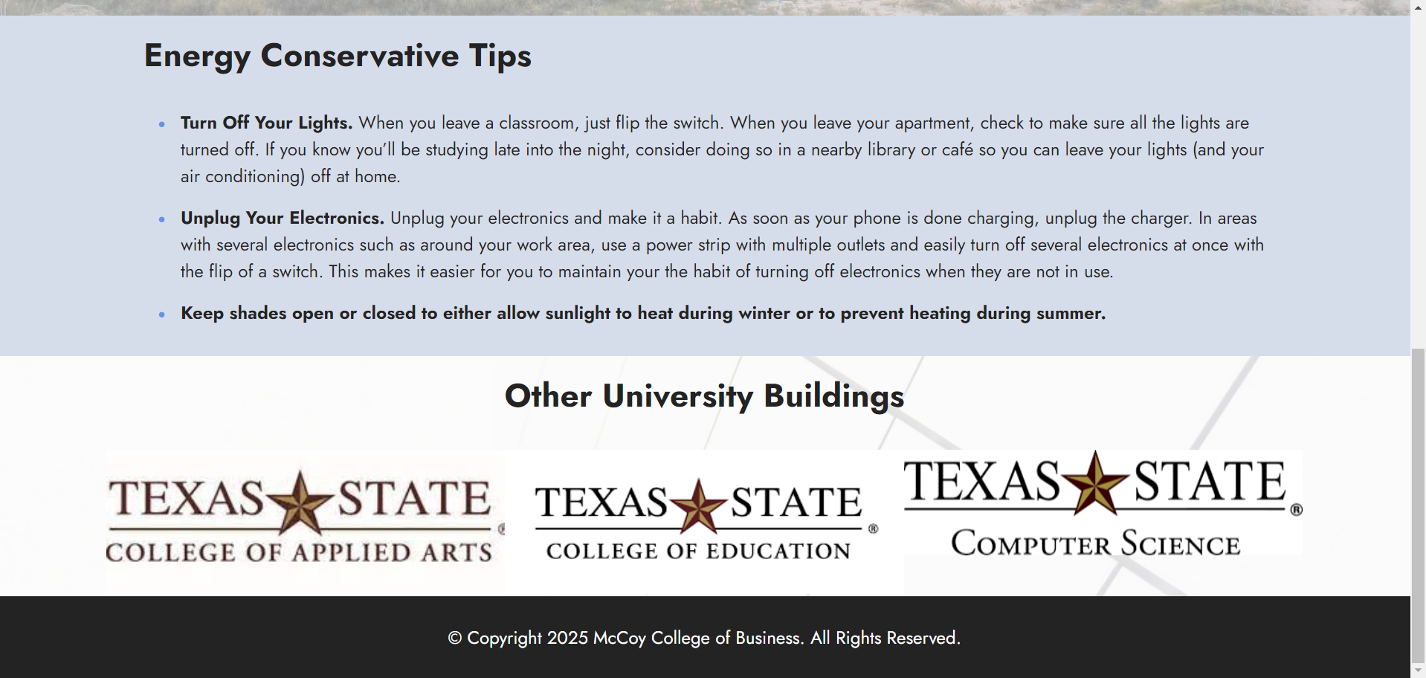
Home Page
This is the Landing / home page for the Dashboard we are working on.

Slide 3
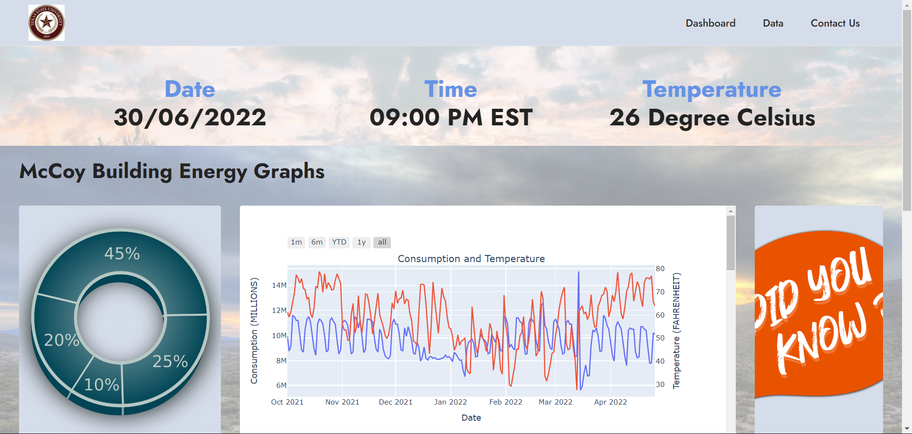
Dashboard Page
This respective page is divided into four sections. The first section of the page consists of the Date, Time and Temperature. The 2nd section of the page consists holds some statistical data, Graphical representation and some facts.

Slide 4
Dashboard Page Continued..
The third Section holds some Energy conservative tips. The fourth section is for the other university buildings for future use, i.e. If we plan on using this energy dashboard for the other university buildings.

Slide 5
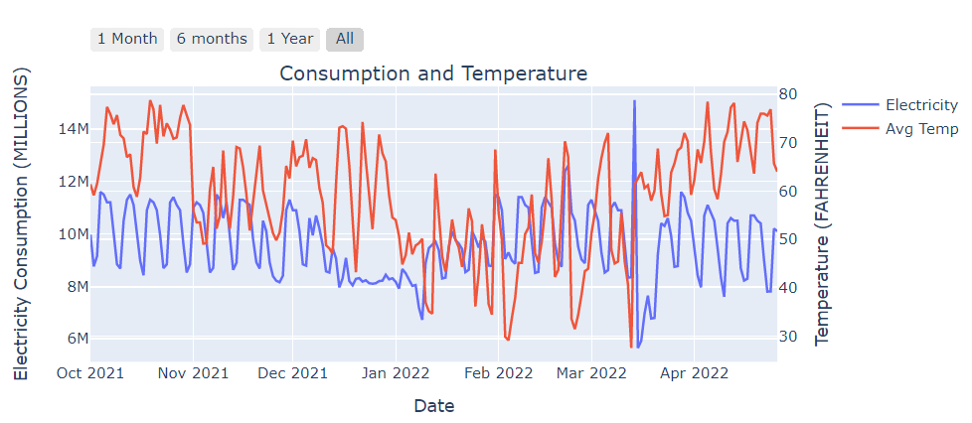
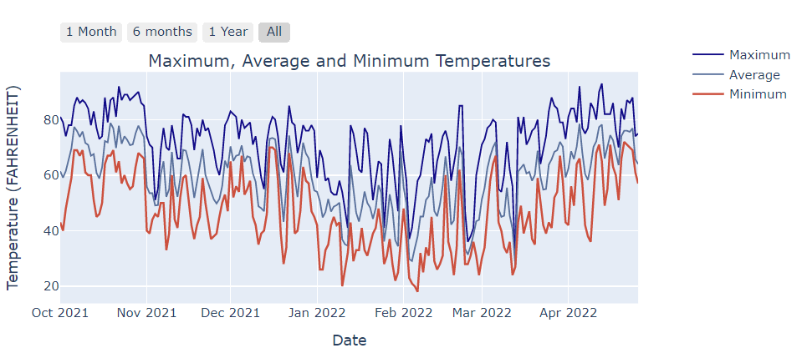
Dashboard Page Visualizations
This Graph Shows the Consumption & Temperature readings plotted over Date for the McCoy Building.
This Graph Shows the Maximum, Average and Minimum Temperatures of the McCoy Building.

Slide 6
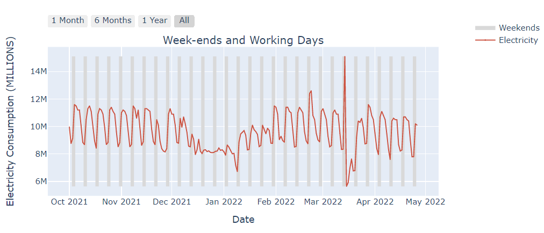
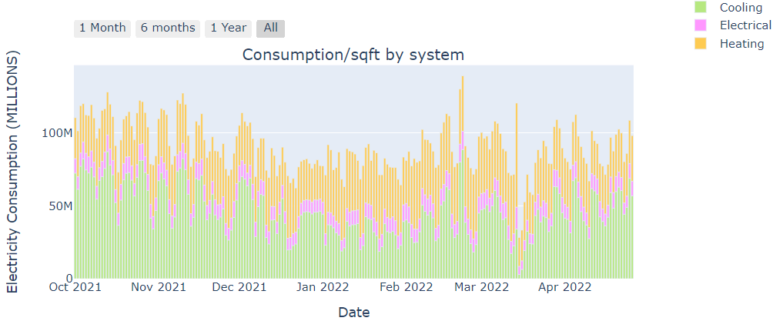
Dashboard Page Visualizations Continued…
This graph shows the Weekends and Working Days Electricity Consumption for the McCoy Building. The Grey Horizontal shade represents the Weekends and the unshaded part is the working days.
This graph Shows the total per day of the different types of Thermal Energy (Chilled Water BTUS, Steam BTUS, Electrical BTUS)

Slide 7
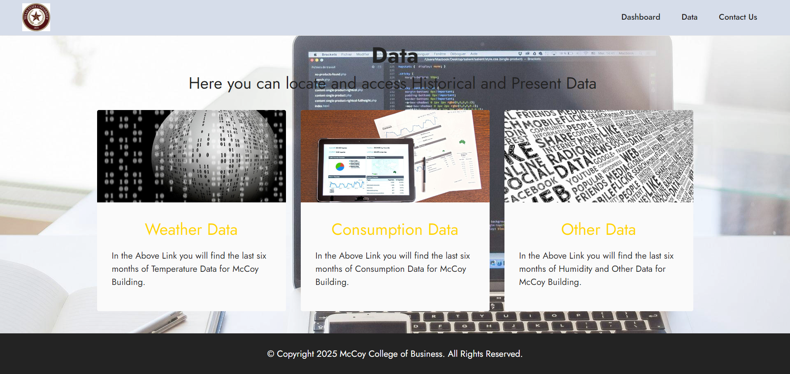
Data Page
This page is from where u can access the data we are using to plot the graphs in the Dashboard Page.

Slide 8
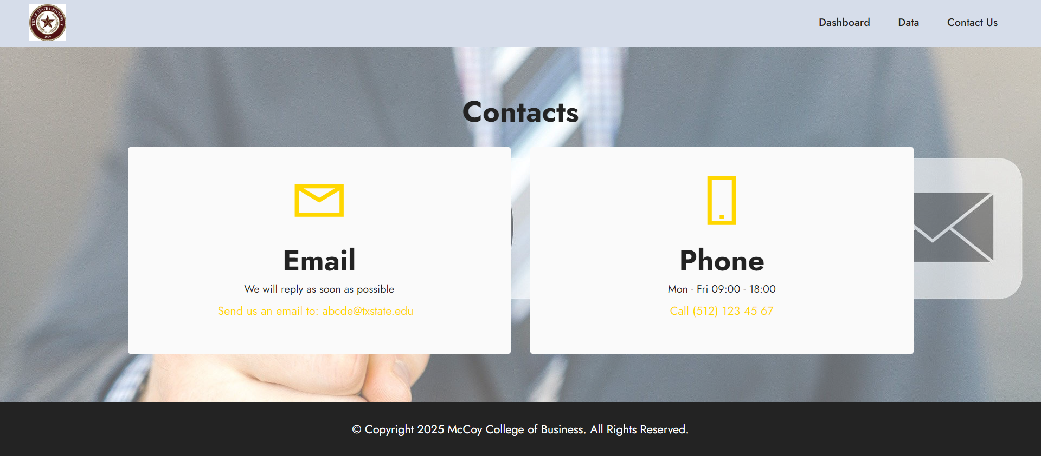
Contact Us Page
Contact Us Page with Email and Phone Number options.

Slide 9
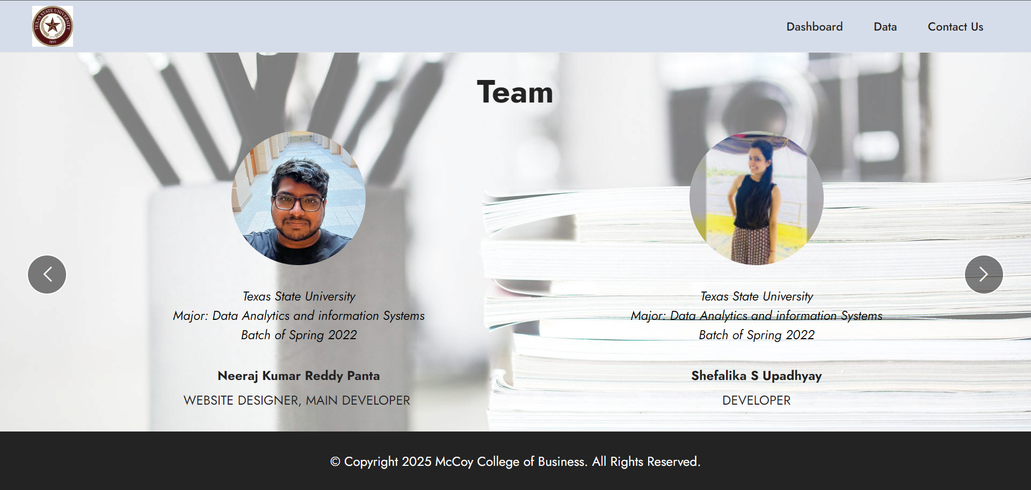
Team

Slide 10
Thank You

